Slide 1









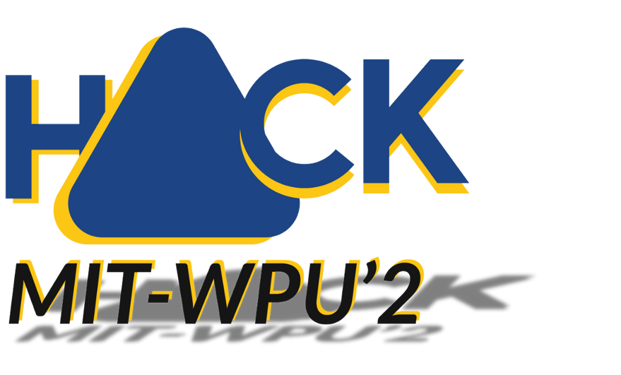


MIT-WPU' 25
ले छलांग
ONE HACKATHON. THIRTEEN TRACKS.
MILLION PROBLEMS. BILLION MINDS.

Slide 2




TEAM NAME
Sr.No
NAME
PHONE
EMAIL ID:
ROLE
1
Anuradha Phadke
+91 9423569145
anuradha.phadke@mitwpu.edu.in
Faculty Mentor
2
Soham Walimbe
+91 7083541780
sohamwalimbe@gmail.com
Team Leader
3
Chaitanya Abhyankar
+91 9922923202
achaitanya93@gmail.com
Team Member 1
4
Ayush Deshmukh
+91 8830383049
ayush30851@gmail.com
Team Member 2
5
Shriya Samridhi
+91 8789524533
1032221380@mitwpu.edu.in
Team Member 3
6
Revati Jagdale
+91 9156412692
revatijagdale04@gmail.com
Team Member 4
Yukti ID: IC201811717

Slide 3

IoTide
Detect the Undetected

Slide 4


ABOUT YOUR IDEA
1
2
3
Overview
Problem Statement
Need Statement
Our project, IoTide, is an IoT-powered underwater monitoring system that utilizes ESP32-CAM for real-time video capture and YOLO-based AI models for marine life and debris detection. Additionally, it incorporates water quality sensors to analyze environmental conditions and assess potential threats to aquatic ecosystems.
Traditional underwater monitoring systems are expensive, lack real-time data transmission, and fail to provide an integrated approach to marine life detection, water quality analysis, and debris identification. These limitations hinder effective conservation and research efforts in aquatic ecosystems.
There is a need for a cost-effective, real-time AI-powered system that integrates marine life recognition, water quality assessment, and debris detection. This solution should help researchers and conservationists analyze underwater environments efficiently while minimizing environmental impact.

Slide 5
PRIOR ART
ROVs & AUVs – Expensive underwater drones for marine monitoring.
Sonar-Based Systems – Used for object detection but lack visual identification.
Manual Diving Surveys – Costly, time-consuming, and limited in coverage.
Satellite Imaging – Ineffective for deep underwater object detection.
PROPOSED
SOLUTION
IoTide is an IoT-powered underwater object recognition system that uses a camera module to capture images and transmit them for real-time processing. A machine learning model analyzes these images to detect and classify marine life and debris. This solution is cost-effective, scalable, and provides real-time insights, making underwater monitoring more accessible and efficient.

Slide 6
Technical Approach
🔹 Hardware Setup:
ESP32-CAM for image capture
USB/Wireless transmission to processing unit (laptop)
TDS sensor to monitor water quality
Power-efficient IoT integration
🔹 Data Processing:
Image preprocessing and enhancement
AI model (YOLOv5) for object detection
Classification of marine life and debris
🔹 Software & AI Model:
Google Colab for training the dataset
TensorFlow/PyTorch for deep learning
Real-time inference using Python in VS Code
🔹 Future Integration:
Underwater wireless transmission (acoustic/satellite)
Cloud-based monitoring and analysis
Edge AI for on-device processing

Slide 7
Project Workflow
ESP 32 Cam will be running a live camera feed on a web server
The python code in VS code will capture the stream running on the webpage
A video will get recorded and will be saved to a local disk
The python code will then run a Machine Learning model on the saved video
While each frame of video is processed, it will update each frame with a box around the object in the water and name the species of the detected aquatic life accordingly
After all the frames are processed with the help of multiple datasets, it will save a processed video at the same location.

Slide 8
USP
✔ Real-Time Image Recognition – Instant detection of marine life and debris. ✔ Cost-Effective IoT Solution – Affordable alternative to expensive ROVs & AUVs. ✔ Wireless Data Transmission – Enables remote monitoring. ✔ Scalable & Versatile – Adaptable for research, conservation, and pollution control. ✔ AI-Powered Insights – Enhances underwater analysis with machine learning.
IMPACT & BENEFIT
✔ Environmental Conservation – Helps in marine pollution detection and cleanup. ✔ Cost-Effective Monitoring – Reduces the need for expensive underwater surveys. ✔ Real-Time Data Collection – Provides instant insights for research and analysis. ✔ Scalability & Accessibility – Can be deployed in various aquatic environments. ✔ Supports Marine Research – Aids scientists in studying underwater ecosystems.

Slide 9
COMMERCIALIZATION/ FEASIBILITY
✔ Market Potential – Can be used in marine research, environmental monitoring, and aquaculture. ✔ Cost-Effective – Uses affordable IoT and AI technologies, making it accessible. ✔ Scalable Deployment – Can be implemented in oceans, lakes, and industrial water bodies. ✔ Revenue Model – Subscription-based monitoring services, partnerships with research institutions, and hardware sales. ✔ Feasible Technology – Utilizes existing IoT and AI frameworks, ensuring practical implementation.
5 YEAR PLAN
✔ Year 1: Develop prototype, train AI model, and conduct pilot testing. ✔ Year 2: Improve performance, form partnerships, and deploy in selected waters. ✔ Year 3: Launch commercially, scale production, and introduce subscription services. ✔ Year 4: Expand globally, enhance AI, and integrate better communication methods. ✔ Year 5: Advance features, explore deep-sea applications, and establish market leadership.

Slide 10
RESEARCH & REFERENCE
We have analyzed multiple research papers and conducted a literature review to understand existing
methodologies, challenges, and technological advancements in this field.
ResearchGate | Find and share research
IEEE Xplore
MDPI - Publisher of Open Access Journals
Makerguides Blog
GitHub

Slide 11

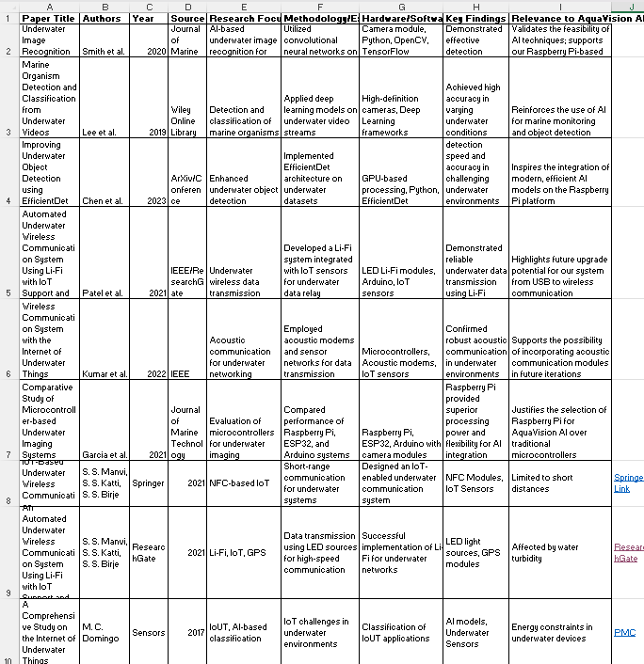
A SNAP OF OUR LITERATURE REVIEW

Slide 12
THANK YOU

